Slide 1
Multi-Agent Ecosystems: Part - 1​
Notes:
Good morning, everyone, and welcome back to Multi-Agent Ecosystems, Part 1.
In our last session, we saw AI move from answering questions to actually doing things. Today we look at how people build those AI workers, and how they get many of them to work together as a team.
Here's the good news: you don't need to write code to follow today. If you can follow a flowchart and you've ever worked in a team, you already understand most of this session.

Slide 2
Designing Agentic Workflows with LangGraph and CrewAI
Notes:
Today's lesson is called Designing Agentic Workflows with LangGraph and CrewAI.
Let me decode that title in one breath. A workflow is simply a series of steps to get a job done, like the steps to approve a loan. Agentic means AI agents do those steps. And LangGraph and CrewAI are two of the most popular toolkits people use to build them.
By the end of the session, you'll know what each tool is good at, and you'll have seen both running live.

Slide 3
RAG: AI that looks things up before it answers, like an open-book exam.
AI agent: AI that doesn’t just answer. It plans and takes action.
Agent loop: plan → act → check → repeat until the goal is met.
Teams of agents: a supervisor plus specialists beats one “do-everything” agent.
Today: the two most popular tools for building those teams.
Notes:
Before we start, a quick recap of where we are.
RAG is AI that looks things up before it answers. It's like an open-book exam: instead of answering from memory, it checks the textbook first.
An AI agent goes one step further. It doesn't just answer, it acts. Think of the difference between a travel website that shows you flight times, and an assistant who actually books the ticket, adds it to your calendar, and messages your family.
Agents work in a loop: plan, act, check, and repeat until the goal is met.
And we saw that, for big jobs, a team works better than one super-agent: a supervisor plus a few specialists.
Today's question is simple: how do people actually build those teams? That's where LangGraph and CrewAI come in.

Slide 4
Picture this: you’re organising a big family wedding. Caterer, decorator, photographer, DJ, and travel for 300 guests.
Option A: one person handles everything.
Option B: a team, each with one clear job, plus a wedding planner who keeps everyone in sync.
Now replace the people with AI agents.
How would you design this AI team? Who does what, in what order, and who checks the work?
Notes:
Let's start with something many of us have lived through: a big family wedding.
There's the caterer, the decorator, the photographer, the DJ, and somebody has to arrange hotel rooms and pickups for 300 guests, half of whom are arriving on different trains.
Option A: that one cousin who says, "Don't worry, I'll handle everything." We all know how that ends. By the sangeet, he's forgotten the flowers, the photographer is at the wrong hall, and he hasn't slept in three days.
Option B: a team. One person owns food, one owns décor, one owns guests, and a wedding planner keeps everyone in sync. Some things must happen in order: the venue has to be booked before the decorator can measure it. Some things happen at the same time: the caterer and the photographer don't need to wait for each other. And someone checks the work before the big day.
Now, replace every person with an AI agent.
Take thirty seconds and think: how would you design this AI team? Who does what, in what order, and who checks the work?
(Pause and take two or three answers.)
Keep your answers in mind. Every idea you just said, roles, order, checking, is exactly what today's tools let you set up.

Slide 5
Explain what LangGraph does, using the idea of a flowchart
Build a small AI team in CrewAI, with clear roles and tools
Choose how agents share work: one by one, all at once, or under a boss
Plan for failure with backups, quality checks, and the speed vs. accuracy trade-off
Decide when to use LangGraph and when to use CrewAI
Notes:
Here's what you'll be able to do by the end of today.
First, explain what LangGraph does, using the idea of a flowchart. If you can read a flowchart, you can understand LangGraph.
Second, understand how a small AI team is built in CrewAI, where each agent has a clear role and its own tools.
Third, choose how agents share the work: one by one, all at once, or with a boss handing out tasks.
Fourth, plan for things going wrong, because they will. We'll talk about backups, quality checks, and the classic trade-off between speed and accuracy.
And finally, decide when to use LangGraph and when to use CrewAI.

Slide 6
Today’s Plan: Learn a Little, See It Live
Short theory, then a live demo. Then repeat.
What we learn | What you see live
Part 1: LangGraph, a flowchart for AI | Demo 1: A research agent that searches the web
Part 2: CrewAI, a team of AI workers | Demo 2: A “receptionist” agent that routes questions
Part 2 (contd.): How the team shares work | Demo 3: Agents working one by one vs. all at once
Part 3: A2A, a common language for agents | Guided practice: agents from different tools working together
Wrap-up: LangGraph or CrewAI? | Jargon buster, key takeaways, and Q&A
Notes:
Here's how today will run. You won't sit through forty slides in a row.
We learn a little, then you see it live. Then we learn a little more, and see it again.
Part 1 is LangGraph. Just a few slides, then Demo 1, where an agent searches the web for us.
Part 2 is CrewAI, the team builder. Demo 2 is a receptionist agent that decides who should answer a question. Then we learn how the team shares the work, and Demo 3 shows agents working one by one versus all at once.
Part 3 is a short look at Google's A2A, a common language that lets agents from different tools talk. Then you get hands-on in the guided practice.
We finish by comparing LangGraph and CrewAI side by side, with a jargon buster you can keep.

Slide 7
Part 1: LangGraph, a Flowchart for AI Agents
Notes:
Part 1: LangGraph.
If you remember just one sentence from this part, make it this one: LangGraph is a flowchart that AI follows.

Slide 8
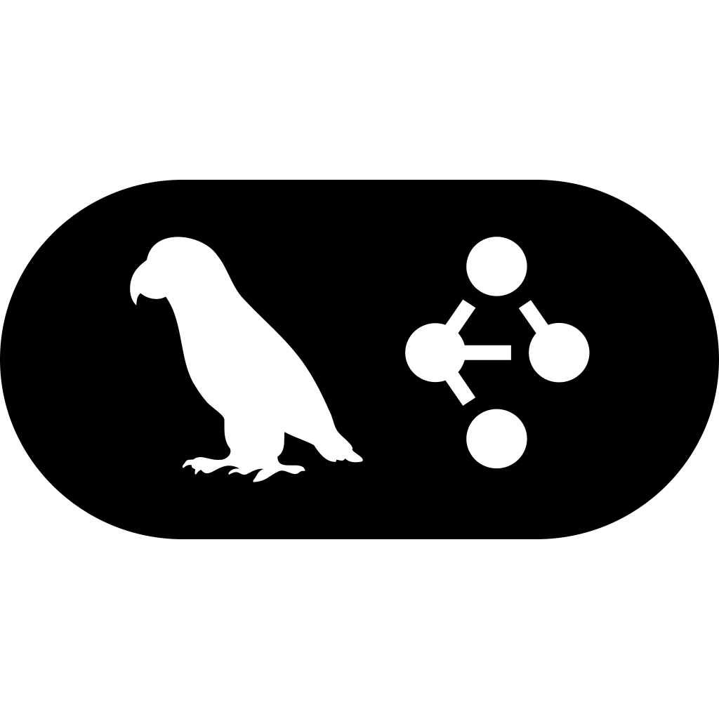
LangGraph: A Flowchart Your AI Follows
A framework is a ready-made toolkit for builders. LangGraph lets AI follow a flowchart: steps, arrows, and decisions.
Where is it used?
Chatbots that remember the conversation, claim and approval processes, and research assistants that search and double-check.
Notes:
First, a word you'll hear a lot today: framework. A framework is a ready-made toolkit for builders. Think of a meal kit. You still cook, but the ingredients are measured and the recipe card is in the box, so you don't start from zero.
LangGraph is one such framework, made by the same team that built LangChain, a popular toolkit for AI apps.
What makes LangGraph special is that it lets you draw the work as a flowchart: boxes for steps, arrows for what comes next, and decision points. The AI then follows that flowchart.
Why would you want that? Because in many businesses, you can't let AI "wing it." A bank, an insurer, or a hospital needs the same steps followed every single time, in the right order, with checks along the way.
LangChain says companies such as LinkedIn, Uber, and Klarna have used LangGraph for agents in their products. You'll find it behind chatbots that remember the whole conversation, approval processes, and research assistants that search, then double-check what they found.

Slide 9
Five Words You’ll Hear in the Demo
Think of a railway map. These five words describe every LangGraph flowchart:
Nodes
the steps
Edges
the arrows
State
shared notes
Guards
if/then checks
Cycles
loop back
Nodes
the steps
Edges
the arrows
State
shared notes
Guards
if/then checks
Cycles
loop back
Notes:
There are five words you'll hear in the demo. Let's learn them with something every Mumbaikar knows: the local train map.
Nodes are the steps. On a train map, these are the stations: Dadar, Bandra, Andheri. In LangGraph, a node is one piece of work, like "read the customer's question" or "search the web."
Edges are the arrows between steps, the tracks connecting the stations.
State is the shared notes that travel along. Think of it as your bag. Whatever you pick up at one station, you carry to the next. In LangGraph, every step can read the notes and add to them.
Guards are if/then checks at a junction. If it's a fast train, skip the small stations. If it's a slow train, stop everywhere. In LangGraph: if the answer is complete, finish; if not, go and search again.
Cycles mean the route can loop back. If a step fails or something is missing, the flowchart can send the work back to an earlier station and try again.
That's it. Nodes, edges, state, guards, cycles. Steps, arrows, notes, checks, and loops.

Slide 10
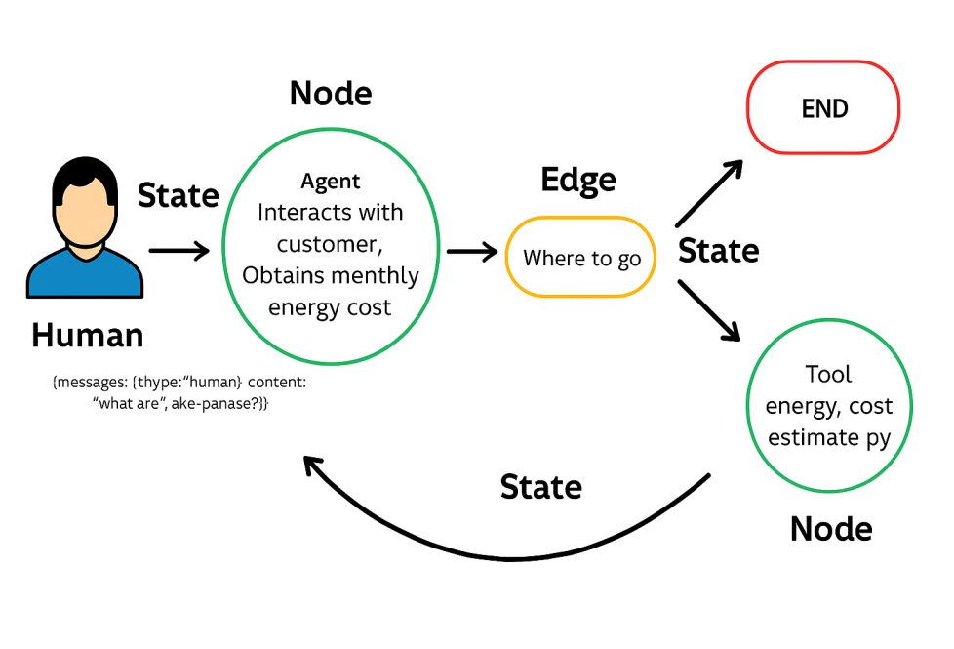
Example: An Electricity Bill Helper
A customer asks a question (node). An arrow decides where to go next (edge). A calculator tool runs, and the notes (state) loop back until the answer is ready.
monthly
Notes:
Let's see those words in one example: an electricity bill helper.
A customer asks a question. Say, "Why is my bill so high this month?" That question goes into the shared notes, the state.
The first node is the agent. It talks to the customer and finds out their monthly usage.
Then we reach an edge, the "where to go" decision. Does the agent have everything it needs to answer? If yes, go to the END. If it needs a calculation, go to the tool node.
The tool node is a small calculator program that estimates the energy cost. Its result is written into the notes, and the flow loops back to the agent, which can now give a proper answer.
Notice the loop at the bottom. That's a cycle. The agent can go to the tool as many times as it needs, then finish.
This exact loop, think, use a tool, think again, answer, is what you'll see in Demo 1.

Slide 11
Three Superpowers of LangGraph
Because LangGraph carries shared notes (called state) through the flowchart, it can do three useful things:
Remembers everything
Every step sees what earlier steps found, like a case file passed from desk to desk.
Pause and resume
It can stop and pick up later without losing work, like a saved game.
Human-in-the-loop
A person approves before a risky step, like a manager signing off a big refund.
Notes:
Because LangGraph carries those shared notes through the whole flowchart, it gets three superpowers.
One: it remembers everything. Every step can see what the earlier steps found, like a case file passed from desk to desk in an office. The fifth desk doesn't ask for your Aadhaar again, because it's already in the file.
Two: pause and resume. The work can stop and pick up later without losing anything, just like a saved game. If you stop a game on level seven, you don't want to start again from level one tomorrow.
Three, and this is the one businesses love: human-in-the-loop. That means a person approves before a risky step. The AI prepares a 2 lakh rupee refund, then stops and waits for a manager to click "approve." Only then does it continue.
This is why LangGraph is popular for serious processes. You get AI speed, but a human still holds the pen on the big decisions.

Slide 12
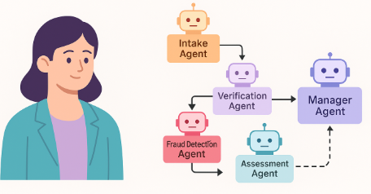
LangGraph in Action: Insurance Claims
The problem: claims bounced between teams by email. Approvals were slow, documents got lost, and nobody knew the status.
The fix: each team becomes an AI agent, and LangGraph draws the route every claim must follow, including a loop back when a document is missing.
Notes:
Here's a real-world kind of example: insurance claims.
Picture the old way. A customer's car is damaged. The claim goes to customer service, who email the document team, who email fraud checks, who email the assessor, who email legal. Every handover is an email. Things get lost. And when the customer calls asking "What's the status?", nobody actually knows.
With LangGraph, each team becomes an AI agent. An intake agent collects the details. A verification agent checks the documents. A fraud agent looks for suspicious patterns. An assessment agent estimates the payout. And a manager agent watches the whole flow.
The important part is the route. LangGraph draws the exact path every claim must follow. And if a document is missing, the flowchart loops back and asks the customer for it, instead of the claim silently getting stuck.
And because the state is always saved, you can see exactly where every claim is, at any moment. That alone saves a lot of phone calls.

Slide 13
A Research Agent with LangGraph
30
Scenario: A fintech product lead wants to keep up with new ways to stop UPI fraud, but reading the news every day takes hours. We’ll build an agent that searches the web with Tavily (a search engine made for AI) and writes a short summary of what it finds.
Note:
Please download the demo document from the reference material section to perform step-by-step execution.
Notes:
Time for Demo 1. Let me set the scene.
A product lead at a fintech company wants to keep up with new ways to fight UPI fraud. New scams appear every week, and reading the news daily takes hours. So we'll build an agent that does the reading for her.
The agent has one tool: Tavily, a search engine made for AI. Google gives you a page of links meant for humans. Tavily gives back clean text that an AI can read.
(Run the demo from the demo document.)
While it runs, watch for three things.
First, the agent decides by itself that it needs to search. We never told it "search now." That's the think step.
Second, look at the messages: you'll see the tool being called, and the results coming back. That's the act step, the arrow going to the tool node and back.
Third, the final answer is built from what it found, not from memory. That's the same loop we saw on the electricity bill slide.
(Ask the room:) What would you add to this flowchart before sending the summary to your boss? Usually someone says "a human check." That's human-in-the-loop, exactly what LangGraph is built for.
Backup plan: if the search key fails or the internet is slow, show the saved output in the demo document and walk through the same three points.

Slide 14
Part 2: CrewAI, a Team of AI Workers
Notes:
Part 2: CrewAI.
If LangGraph is a flowchart, CrewAI is a team. Instead of drawing every step, you hire roles and give each one a goal.

Slide 15
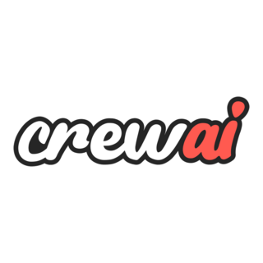
CrewAI: Hire a Team of AI Workers
CrewAI is a framework for building a crew: a team of AI agents where each one has a job title, a goal, and its own tools.
Just like a real team: a researcher finds facts, a writer drafts, an editor checks. Each agent sticks to its job.
Notes:
CrewAI is a framework for building a crew: a team of AI agents where each one has a job title, a goal, and its own tools.
Think about how a newspaper story gets made. A reporter finds the facts. A writer turns them into a story. An editor checks it before it's printed. Nobody does everyone's job. Each person sticks to their role and passes the work on.
CrewAI copies exactly that. You write, in plain English, something like: "You are a market researcher. Your goal is to find the three biggest trends. You can use web search." Then a second agent: "You are a writer. Turn the research into a one-page brief."
That's a big reason CrewAI became popular so quickly: the setup reads almost like a job description. Even non-programmers can look at a CrewAI design and understand what each agent is supposed to do.

Slide 16
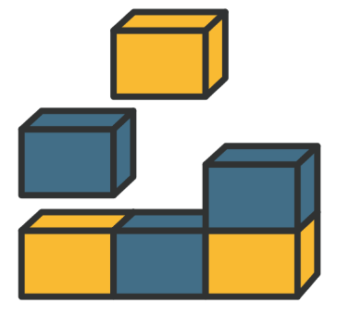
The Six Building Blocks of a Crew
Every CrewAI team is built from six parts. Picture a restaurant kitchen:
Roles
job titles
Agents
the workers
Tools
their equipment
Permissions
what’s allowed
Memory
notes they keep
Coordination
who goes when
Notes:
Every crew is built from six parts. Let's use a restaurant kitchen.
Roles are job titles: head chef, tandoor cook, pastry chef. The role says what you're responsible for.
Agents are the workers who fill those roles. The role is "tandoor cook." The agent is the actual person at the tandoor.
Tools are their equipment. The tandoor cook gets the tandoor and skewers. The pastry chef gets the oven and piping bags. You don't hand the pastry chef a meat cleaver.
Permissions are what each worker is allowed to do. A junior cook can cook, but can't change the menu or give a customer a discount.
Memory is the notes they keep. The order slips on the rail that everyone in the kitchen can see are shared memory. A chef's secret recipe notebook is private memory.
And coordination is who goes when. Starters go out first, the main course next, dessert last. But the dal and the naan can be made at the same time.
Roles, agents, tools, permissions, memory, coordination. Get these six right, and your AI crew runs like a good kitchen.

Slide 17
Memory: Private Notebook or Shared Whiteboard?
Memory is what an agent remembers while it works. You decide whether agents keep it private or share it:
Memory isolation (private notebook) | Memory sharing (shared whiteboard)
Each agent sees only its own notes | All agents read and add to the same notes
Keeps sensitive data safe | Keeps everyone in sync
Best for: patient records, salaries, fraud checks | Best for: co-writing a report, planning a campaign
Like a doctor’s private case file | Like a team’s WhatsApp group
Risk: agents may repeat each other’s work | Risk: one wrong note misleads everyone
Notes:
Let's zoom into one of those blocks: memory. Memory is what an agent remembers while it works, and you get to decide whether it's private or shared.
Memory isolation is a private notebook. Each agent sees only its own notes. Think of a doctor's case file. The receptionist doesn't get to read your diagnosis.
Use this when data is sensitive: patient records, salaries, or a fraud-checking agent whose findings shouldn't reach the marketing agent.
Memory sharing is a shared whiteboard, or, let's be honest, a team WhatsApp group. Everyone reads and adds to the same notes.
Use this when agents need to stay in sync, like three agents co-writing one report. If the researcher finds something, the writer should see it straight away.
Each has a risk. With private notebooks, agents might repeat each other's work, because nobody knows what the other found. With a shared whiteboard, one wrong note misleads everyone. We've all seen one wrong forward mislead an entire family WhatsApp group.
So the question to ask is simple: does this information need protecting, or does it need spreading?

Slide 18
CrewAI in Action: Faster Loan Approvals
The problem: a digital bank wants to approve loans faster without breaking any rules.
The crew: five agents. An ID checker, a credit scorer, a fraud spotter, an eligibility checker, and a paperwork writer.
What changes:
Each agent does one job well, then passes the file on
More applications handled, rules still followed
Faster approvals
Fewer missed checks and mistakes
Notes:
Here's CrewAI in a real-world scenario: loan approvals at a digital bank.
The bank wants to approve loans faster, but it can't cut corners. There are strict rules about checking identity, checking credit, and spotting fraud.
So we build a crew of five agents. An ID checker verifies documents, like a KYC check. A credit scorer looks at credit history. A fraud spotter looks for warning signs, like a brand-new phone number and five loan applications in one day. An eligibility checker matches the applicant against the loan rules. And a paperwork writer prepares the compliance documents.
What changes? Each agent does one job well, then passes the file on. The bank handles more applications without breaking rules. Approvals get faster. And there are fewer missed checks, because no single agent is juggling everything.
Notice it's exactly the wedding team from the start of the session. One clear job per member, and clear handovers.

Slide 19
Why do we give each agent only the tools its role needs?
So agents can do more tasks without limits
So every agent can use every tool
So each agent uses only what its job requires
So agents can take over other agents’ tools
Notes:
Quick check. Why do we give each agent only the tools its role needs?
Option A: so agents can do more tasks without limits. Option B: so every agent can use every tool. Option C: so each agent uses only what its job requires. Option D: so agents can take over other agents' tools.
(Give the room 15 seconds.)
The answer is C.
Think back to the kitchen: you don't give the pastry chef the meat cleaver. Fewer tools means fewer mistakes, less confusion about which tool to use, and less damage if something goes wrong. If the fraud agent can't send emails, it can never accidentally email a customer.

Slide 20
A “Receptionist” Agent with CrewAI
30
Scenario: A knowledge website gets hundreds of questions a day. Some need fresh information from the web, some don’t. We’ll build two agents: a router (the receptionist) that decides if a web search is needed, and a researcher who searches and answers. Fast answers, and no wasted searches.
Note:
Please download the demo document from the reference material section to perform
step-by-step execution.
Notes:
Demo 2: a receptionist agent with CrewAI.
Here's the scene. A knowledge website gets hundreds of questions a day. Some need fresh information from the web, like "What's today's gold price?" Some don't, like "What does inflation mean?" Searching the web for every question is slow and costs money.
So we build a crew of two. The first agent is the router. Think of it as the receptionist at a hospital: it doesn't treat you, it decides which doctor you should see. The second agent is the researcher, who has the web search tool.
(Run the demo from the demo document.)
Let's test it with two questions. First, a timeless one: "What is a mutual fund?" Watch the router decide no search is needed.
Now a fresh one, like "What's the latest news on UPI fraud?" Watch the router send it to the researcher, who searches and answers.
Point out the agent definitions on screen: role, goal, and backstory. Read one out loud. It reads like a job description, which is the whole idea of CrewAI.
Backup plan: if the search tool fails, show the saved output and ask the class to guess, question by question, which ones the router would send for a search.

Slide 21
Four Ways Agents Share the Work
Coordination means who works when. A crew can follow one of four patterns:
Serial (one by one)
Parallel (all at once)
Hierarchical (a boss assigns)
Dynamic (changes plan on the go)
Notes:
So the crew has its roles. Now, who works when? That's called coordination, and there are four patterns. Let's use Mumbai's famous dabbawalas, who deliver around two lakh lunch boxes every day, with famously few mistakes.
Serial means one by one. The tiffin goes from the home collector, to the train, to the station sorter, to the office delivery person. Each step waits for the one before it. In AI: the researcher finishes, then the writer starts.
Parallel means all at once. Thousands of dabbawalas work at the same time on different routes, and nobody waits for anyone else. In AI: one agent researches competitors while another researches customers, at the same time. Faster, as long as the tasks don't depend on each other.
Hierarchical means a boss assigns the work. Like a cricket captain deciding who bowls the next over. In AI: a manager agent looks at the job and hands pieces to specialist agents.
Dynamic means the plan changes on the go. Think of Google Maps rerouting you when there's a jam on the Western Express Highway. In AI: if a search fails or a customer gives an unexpected answer, the crew takes a different path.
Most real systems mix these. The dabbawalas themselves are serial for each tiffin, parallel across routes, and have supervisors on top.

Slide 22

Plan B: When an Agent Fails
Agents fail too: a website is down, or an answer comes back wrong. A fallback is a Plan B that keeps the work moving:
Try again
Give a simpler answer
Backup agent
Escalate to a supervisor
Notes:
Now an uncomfortable truth: agents fail. A website is down. A connection times out. An answer comes back in the wrong format. The question isn't whether it'll fail, but what happens when it does.
A fallback is a Plan B that keeps the work moving. There are four kinds.
Try again. Like redialling when a call drops. Often the second attempt just works.
Give a simpler answer. If the live gold price can't be fetched, say "I couldn't get today's price, but yesterday's was this." Something useful is better than an error message. Builders call this graceful degradation.
Backup agent. If the main agent fails, a second one takes over, like a substitute teacher when the regular teacher is absent.
Escalate to a supervisor. If nothing works, hand it to a manager agent or a human. Like a call centre saying, "Let me transfer you to my senior."
A system that plans for failure feels reliable to customers, even when things are breaking behind the scenes.

Slide 23
Guardrails: Check the Work Before It Moves On
A guardrail is an automatic quality check. Before an agent’s work goes to the next step, it must pass:
01
03
02
04
Check the answer
Send it back if wrong
Limit the retries
Pass only good work
Like a quality checker at the factory gate: nothing faulty leaves the line.
Notes:
Fallbacks handle failures. Guardrails stop bad work from moving forward.
A guardrail is an automatic quality check. Before an agent's work goes to the next step, it has to pass.
Here's why it matters, with a real story. Air Canada's website chatbot told a grieving passenger he could buy a full-price ticket and claim a bereavement discount afterwards. That wasn't the airline's policy. When he asked for the refund, Air Canada said the chatbot was wrong. In 2024, a Canadian tribunal disagreed, said the airline was responsible for what its chatbot said, and ordered it to pay. One unchecked answer cost money and made headlines around the world.
A guardrail works in four steps. Check the answer: does it follow the policy? Is it in the right format? Send it back if it's wrong, so the agent tries again. Limit the retries, say three attempts, so it doesn't loop forever. And pass only good work to the next step.
It's the quality checker at the factory gate. Nothing faulty leaves the line.

Slide 24
Speed vs. Accuracy: The Big Trade-off
Every extra agent or check makes answers better, but slower. Your job is to pick the right balance:
01
02
Speed (latency)
Accuracy
Notes:
Every AI team faces one big trade-off: speed versus accuracy.
Speed is measured as latency. Latency simply means waiting time, how long you wait for the answer. Think about a food delivery app. If your order shows "45 minutes," you might cancel and order elsewhere.
Accuracy is how correct the answer is. A fast answer that's wrong is worse than useless. Imagine the delivery arriving in 10 minutes, but with someone else's food.
Every extra agent or check you add makes answers better, but slower. And usually more expensive too.
Here's a real example. In 2024, the payments company Klarna announced its AI assistant was doing the work of about 700 customer service staff, and resolving chats much faster. About a year later, its CEO admitted that the focus on cost had hurt quality, and Klarna started bringing humans back into customer service.
So the right balance depends on the job. A chatbot answering "What are your opening hours?" should be fast. An agent approving a loan or reading a medical report should be slower and careful. Your job as the designer is to decide which is which.

Slide 25
Which pattern has agents working at the same time, without waiting for each other?
Serial (one by one)
Hierarchical (a boss assigns)
Parallel (all at once)
Dynamic (changes plan on the go)
Notes:
Quick check. Which pattern has agents working at the same time, without waiting for each other?
Serial, hierarchical, parallel, or dynamic?
(Give the room 10 seconds.)
The answer is C, parallel. Like thousands of dabbawalas working on different routes at the same time. Serial is one by one, hierarchical has a boss assigning work, and dynamic changes the plan on the go.

Slide 26
Agents Working One by One vs. All at Once
30
Scenario: A leader at a consumer goods company (think soaps, snacks, shampoo) wants a quick brief on how AI is changing the industry. One agent researches the latest trends, another writes an executive summary. First we run them one by one, then side by side, and compare.
Note:
Please download the demo document from the reference material section to perform step-by-step execution.
Notes:
Demo 3: agents working one by one versus all at once.
The scene: a leader at a consumer goods company, think soaps, snacks, and shampoo, wants a quick brief on how AI is changing the industry. We'll use two agents: a researcher and a writer.
(Run the serial version from the demo document.)
First, serial. The researcher finds the latest AI trends, and then the writer turns them into an executive summary. Point out that the writer waits. It needs the research first.
(Now run the parallel version.)
Now, parallel. Here the two agents get separate jobs that don't depend on each other, and they run at the same time. In the code, it's one setting that basically says "don't wait." Point it out on screen.
Ask the room: which run was faster? And when would parallel be a bad idea? The answer: whenever one task needs another task's output. You can't write the summary before the research exists. It's the wedding again: the decorator can't decorate a venue that isn't booked yet.
Backup plan: if a run is slow or fails, show the saved outputs in the demo document.

Slide 27
LangGraph or CrewAI? Which One When
Both build teams of agents. The difference is how you describe the work:
LangGraph (the flowchart) | CrewAI (the team)
You draw every step and every turn | You hire roles and give each a goal
You control the exact route | The crew works out much of the route
Best for strict processes: claims, approvals, compliance | Best for role-based work: research, writing, planning
Can loop back, pause, and wait for a human | Quick to set up, easy to read and explain
Like a train on fixed tracks | Like a project team with a manager
Notes:
We've now seen both tools. So which one should you use?
Both build teams of agents. The difference is how you describe the work.
With LangGraph, you draw every step and every turn. You control the exact route. With CrewAI, you hire roles and give each a goal, and the crew works out much of the route itself.
LangGraph is best for strict processes, where the steps must be followed exactly: insurance claims, approvals, compliance. It can loop back, pause, and wait for a human.
CrewAI is best for role-based work: research, writing, planning. It's quick to set up and easy to explain to anyone.
The simplest way to remember it: LangGraph is a train on fixed tracks. It always goes exactly where the tracks go. CrewAI is a project team with a manager. You tell them the goal, and they figure out how to get there.
And they're not rivals. In the guided practice, you'll see them used together.

Slide 28
Part 3: Google A2A, a Common Language for Agents
Notes:
Part 3: Google's A2A. This is short, but important, because it answers a question you may already be asking: what if my agents were built with different tools?

Slide 29
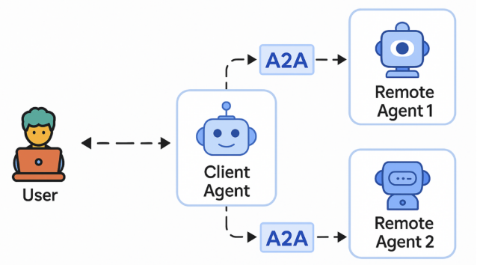
Google A2A: Helping Agents Talk to Each Other
A2A (Agent-to-Agent) is a protocol: a shared set of rules so agents built with different tools, by different companies, can talk and hand over work.
Why it matters
Without it, a CrewAI agent and a LangGraph agent are like two people with no common language. A2A is that common language.
Notes:
Here's the problem. One team in your company builds an agent with CrewAI. Another team uses LangGraph. A vendor sells you a third agent built with something else entirely. They can't talk to each other. It's like putting a Tamil speaker, a German speaker, and a Japanese speaker in one meeting with no translator.
A2A, which stands for Agent-to-Agent, solves this. It's a protocol, which simply means a shared set of rules for communication.
You already rely on protocols every day without knowing it. Email works whether you use Gmail or Outlook, because they follow the same email rules. UPI works whether you pay from Google Pay, PhonePe, or Paytm, because they all follow the same UPI rules. A2A aims to be that for AI agents.
Google announced A2A in April 2025 with more than 50 partner companies, and later handed it over to the Linux Foundation, a neutral non-profit, so that no single company controls it.

Slide 30
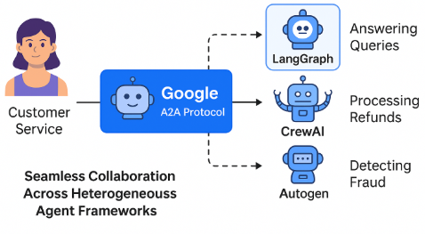
A2A in Action: One Help Desk, Many Agents
Agents built by different teams, now working as one
Scenario: A company’s help desk has three agents: one answers questions, one processes refunds, one spots fraud. Different teams built them with different tools, so they couldn’t talk. With A2A, each agent shares an “agent card” (a digital business card of what it can do), so the others can find it and hand over work.
Notes:
Here's A2A in action: a company help desk.
There are three agents. One answers customer questions, one processes refunds, one spots fraud. Different teams built them with different tools, so they couldn't talk. The customer explains the problem to the first agent, then has to explain it all over again when they're passed to the refund agent. Sound familiar? It's every bad call centre experience.
With A2A, each agent publishes an agent card. Think of it as a digital business card: "I'm the refund agent, here's what I can do, and here's how to reach me."
Now the question-answering agent can look up the cards, find the refund agent, and hand over the case, with the full history attached. The customer explains once, and the agents handle the rest behind the scenes.

Slide 31
30
In this guided practice, you’ll connect agents built with different tools (LangChain, CrewAI, and OpenAI) into one workflow, using LangGraph and A2A.
The flow: you type a question → one agent works out what you need → another searches the web → a final agent writes the answer.
By the end, you’ll see agents from different tools sharing the same notes and finishing one job together.
Notes:
Now it's your turn.
In this guided practice, you'll connect agents built with different tools, LangChain, CrewAI, and OpenAI, into one workflow, using LangGraph as the flowchart and A2A as the common language.
Here's the flow. You type a question. One agent works out what you actually need. Another searches the web. And a final agent writes the answer.
As you go, keep an eye on three things: which agent is working at each step, what's being written into the shared notes, and where the work is handed from one agent to the next.
Try changing the question and watch whether the route changes. That's the flowchart making decisions.
Work in pairs if you like. I'll walk around, and there are no silly questions here. If something breaks, that's a great chance to talk about fallbacks.
(Allow about 30 minutes. Refer to the guided practice document for the steps.)

Slide 32
Jargon Buster
Word | Plain meaning | Everyday picture
Agent | AI that plans and takes actions toward a goal | A personal assistant, not just an advisor
Framework | A ready-made toolkit for building AI apps | A meal kit: ingredients and recipe included
Node / Edge | A step in the flowchart / the arrow to the next step | Railway stations / the tracks between them
State | Shared notes passed from step to step | A case file moving from desk to desk
Tool | Something an agent can use: web search, calculator, database | A worker’s equipment
Guardrail | An automatic check before work moves on | A quality checker at the factory gate
Fallback | Plan B when an agent fails | A backup generator in a power cut
Human-in-the-loop | A person approves before a risky step | A manager signing off a big refund
Latency | How long you wait for the answer | Waiting time for a food delivery
Protocol (A2A) | Shared rules so agents can talk to each other | A common language at a meeting
Notes:
Here's your jargon buster. Every technical word from today, in plain language, with an everyday picture. Feel free to take a photo of this slide.
An agent is AI that plans and takes action: a personal assistant, not just an advisor.
A framework is a ready-made toolkit, like a meal kit.
Nodes and edges are the steps and arrows in the flowchart: the stations and the tracks.
State is the shared notes: the case file moving from desk to desk.
A tool is something an agent can use, like web search or a calculator: the worker's equipment.
A guardrail is an automatic check: the quality checker at the gate.
A fallback is Plan B: the backup generator in a power cut.
Human-in-the-loop means a person approves before a risky step.
Latency is waiting time, like a food delivery estimate.
And a protocol, like A2A, is a shared set of rules so agents can talk: a common language at a meeting.

Slide 33
LangGraph is a flowchart for AI: steps, arrows, shared notes, and human sign-off.
CrewAI is a team of AI workers with roles, goals, tools, and memory.
Agents share work one by one, all at once, under a boss, or by adapting on the go.
Good systems plan for failure: guardrails check the work, fallbacks keep it moving.
A2A gives agents from different tools a common language.
Notes:
Let's wrap up with five takeaways.
One: LangGraph is a flowchart for AI. Steps, arrows, shared notes, and a human can sign off before risky steps.
Two: CrewAI is a team of AI workers, each with a role, a goal, tools, and memory.
Three: agents share work one by one, all at once, under a boss, or by adapting on the go. Just like the dabbawalas.
Four: good systems plan for failure. Guardrails check the work, and fallbacks keep it moving. Remember the Air Canada chatbot.
Five: A2A gives agents from different tools a common language, the way UPI connects every payment app.
Now go back to the wedding question from the start. You now have the words to design that AI team: the roles, the order, the checks, and the backup plans.

Slide 34
Notes:
That brings us to the end of today's session. Thank you for your energy and your questions.
What questions do you have? Nothing is too basic. If one person is wondering about something, at least three others are too.
(If the room is quiet, ask:) If you could build one AI crew for your own work tomorrow, what would its first two roles be?

